Slide 1
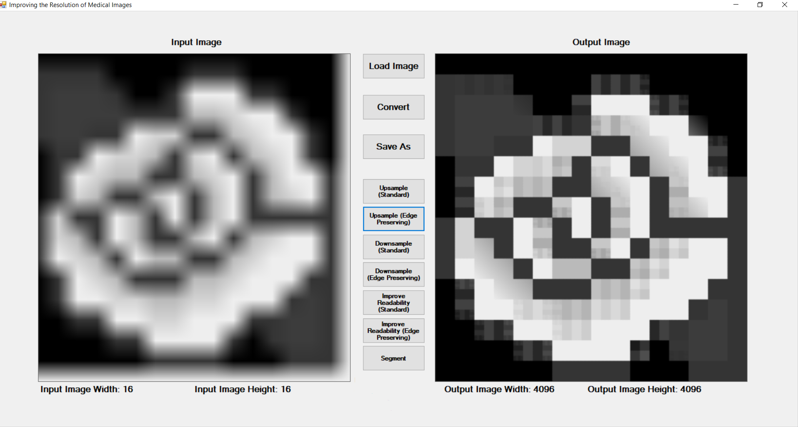
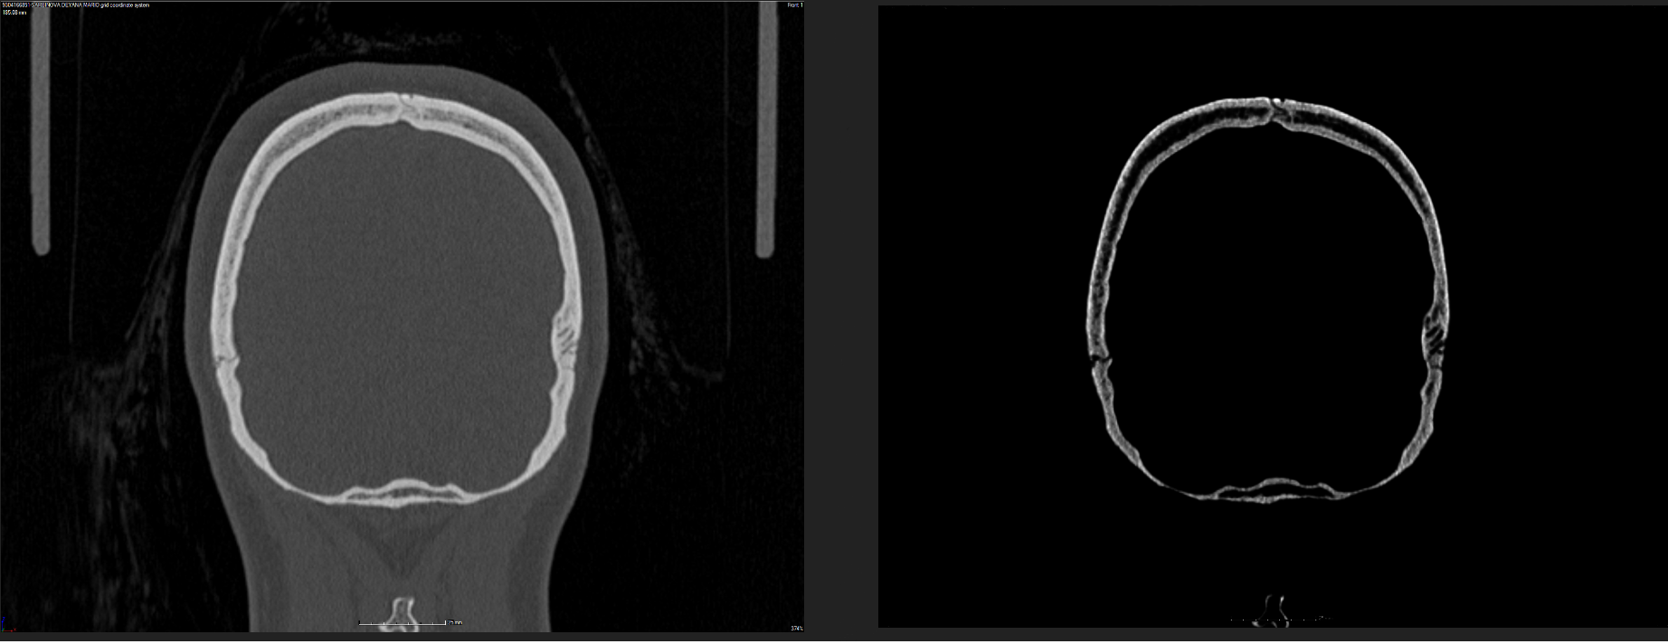
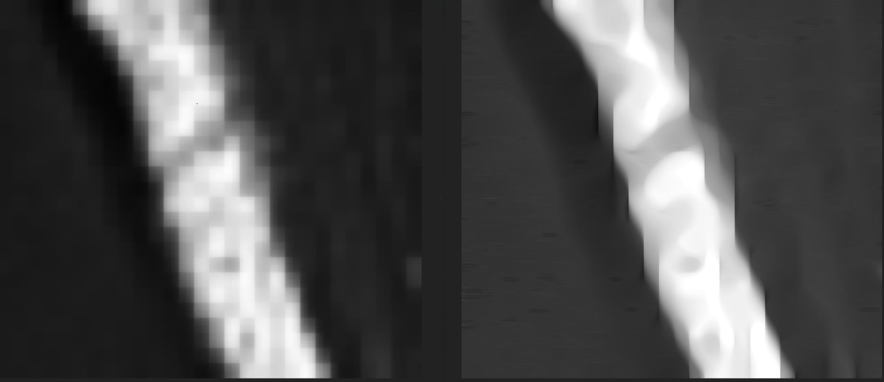
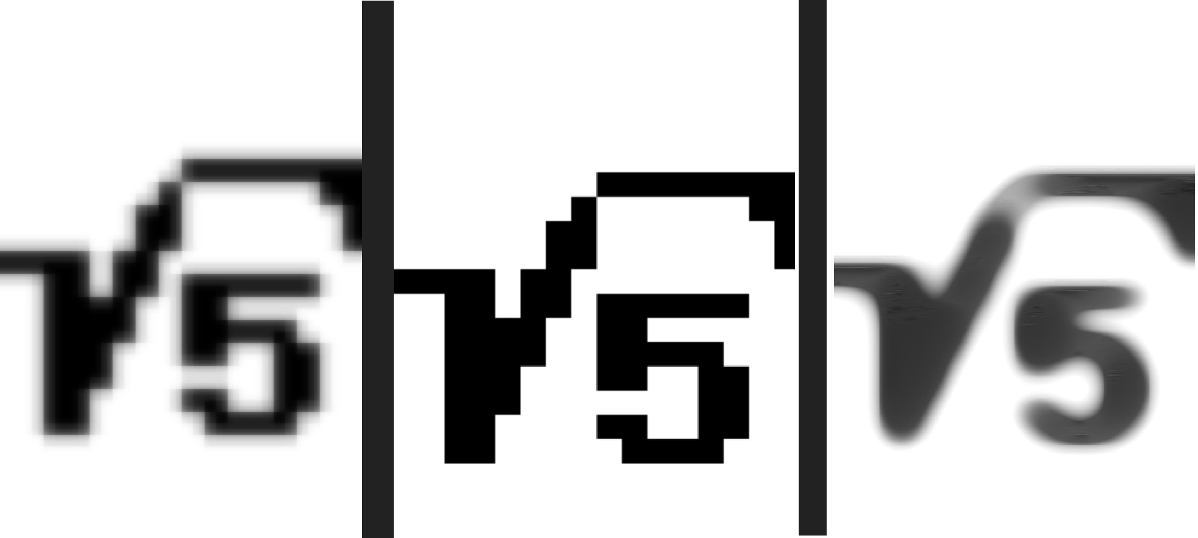
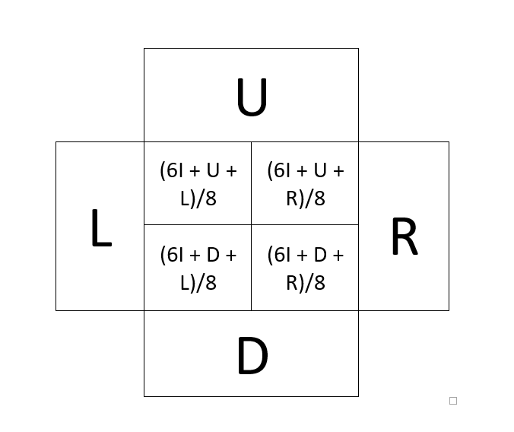
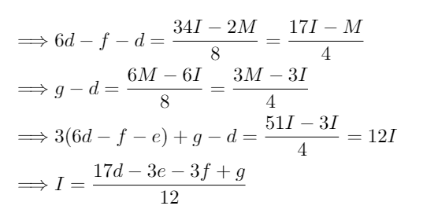
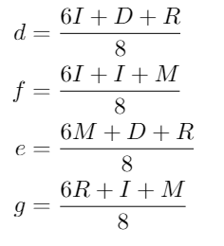
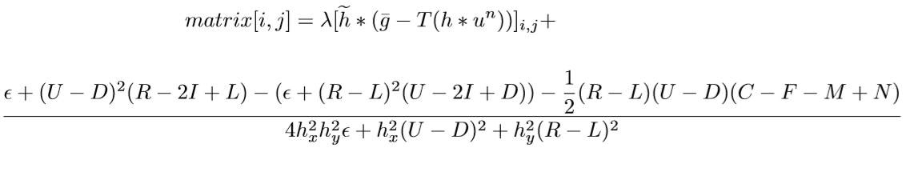
Improving the Resolution and Readability of Two Dimensional Medical Images through Mathematical Transformations
Author: David Kamenov [1] Mentor: Stanislav Harizanov [2]
[1] Maths and Science High School “St. Kliment Ohridski”, 12 grade, 3400 Montana Bulgaria
[2] Bulgarian Academy of Sciences, Institute of Mathematics and Informatics, Department of Mathematical Modelling and Numerical Analysis / Institute of Information and Communication Technologies, Department of Scientific Computations, 1113 Sofia, Bulgaria
Introduction
Software application
Digital image processing is a modern and extremely active scientiﬁc ﬁeld that combines research techniques from mathematics and informatics. The obtained scientiﬁc results are applicable practically almost everywhere, e.g., in medicine, engineering, national security, photography, material sciences, production quality control, archaeology, architecture and many others. It is highly applicable in the field of space exploration including satellites and GPS technologies.
Fig.4: Screenshot of the software application
Abstract
This project is focused in the fields of theoretical informatics, nonlinear optimisation and mathematical modelling. It aims to achieve better overall image quality, to increase its resolution and extract reliable information from medical / industrial topographical images. Despite its main medical purpose, it is multifunctional and can be applied in another fields featuring digital images.
This project is devoted to an important issue in medical X-ray and CT imaging, namely how to increase the image resolution and image readability without exposing the patient to higher radiation. This is an unsolved problem in the CT community where Radon techniques are used, as the resolution of the image depends on the number of the generated 2D radiographic projections, thus is proportional to the radiation dose. Alternatively to the most popular approach of using Machine Learning and Convolutional Neural Networks (CNN), here, we analyse a more theoretical approach, based on both Multi-resolution analysis (MRA) techniques and total variation (TV) energy minimization.
Results
Fig.5: Medical image: Scull
Aim of the project
The aim of the project is to get better overall image readability and higher resolution. . Standard approach simply increases the radiation level to achieve this. Here, it is aimed to use as less X-ray and CT scanner radiation as possible. Thus, the main purpose is to reduce the chance of doctor error caused by insufficient and inaccurate information and to increase the chance of successful treatment of the disease while using as little radiation as possible. In this way, the project can help save human lives.
Algorithms description
Left: Original image
1737x1366 px.
Right: 3 up-scaling steps (EP, EP, BSp);
Segmented 13888x10928 px.
The change in the image resolution is obtained via the application of the so called upsampling operator U and down-sampling operator D. The latter is the left inverse of the former, i.e., DU = Id, meaning that if we increase the resolution of an image and then decrease it, without performing any additional modiﬁcations in-between, we should derive the original image. We consider two different classes of operators U. The ﬁrst class is based on B-spline subdivision and is the natural generalization of the simplest choice for U - the constant mapping, where apparent pixel is split in to four children pixels, each of them inheriting the same gray-scale intensity as their predecessor. Increasing the degree of the B-spline, we increase the regularity of the high-resolution image. On one hand, this ﬁlters the noise image, but on the other - reduces the contrast along the image edges and introduces blurring effects.
The second class is based on piece-wise linear edge-preservation [1] and incorporates structural image information into the up-sampling, thus avoids the blurring effects. All the considered operators U are compactly-supported and local. The corresponding operators D are again local, but also linear. The gray-scale intensity of the parent pixel is always a weighted average of gray-scale intensities of neighbouring children pixels. When U is edge preserving, all the weights are positive (convex combination), while in the case of B-splines some of the weights become negative, which creates additional numerical problems.
Fig.6: Medical image: Bone
Left: 25×28 px. Right: 1600×1792 px.
Fig. 7: Computer vision AI dataset: Mathematical image
Algorithms formulas
Fig 1: Upsampling Algorithm
Fig. 2: Downsampling Algorithm
Input image
16x24 px.
Upsampling (Edge Preservation)
1024x1536 px.
Improving Readability
1024x1536 px.
Acknowledgements
Fig. 3: Algorithm for improving the readability
The support through the Bulgarian NSF Grant DN01/15 from 20.12.2016 is highly appreciated. D. Kamenov and S. Nikolova are also partially supported by the Small Educational-Research Community, funded by the BAS High School Institute under the governmental programme “Education in Science”.
References
[1] S. Joshi, A. Marquina, S. Osher, I. Dinov, J. Van Horn, A. Toga, Edge-enhanced image reconstruction using (TV) total variation and Bregman reﬁnement, International Conference on Scale Space and Variational Methods in Computer Vision, LNCS Volume 5567, pp. 389–400, Springer, Berlin, Heidelberg, 2009.

